Slide 1



PEILab Group Meeting
Leader: Zicong Hong
Team Member: Jian Lin, Haodong Wang, Qianli Liu, Kaibin Guo, Junjie Liu

Slide 2
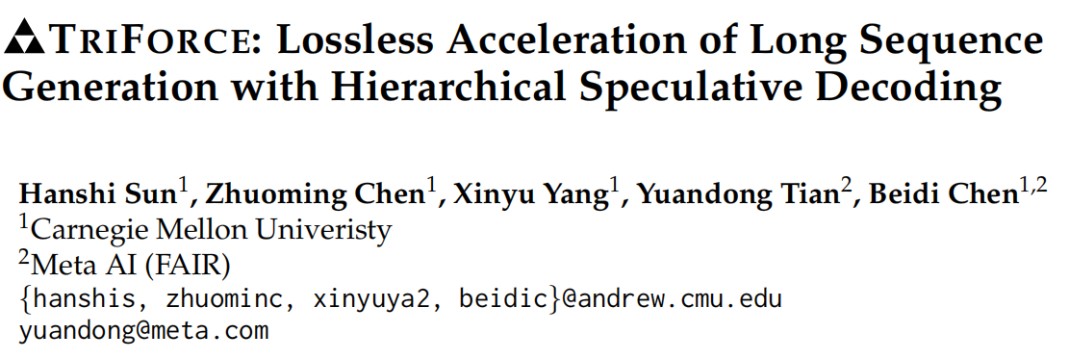
TriForce
COLM’24

Slide 3
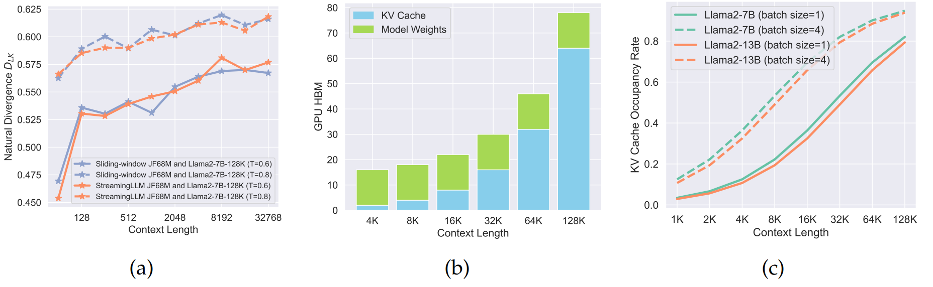
TriForce
Motivation
This work focuses on long sequence generation tasks, which presents unique challenges.
Because of the autoregressive nature of LLMs, the entire key-value (KV) cache, which stores intermediate
key-value states from previous contexts to avoid re-computation, together with model parameters will be loaded into GPU SRAM for every token generated, resulting in low utilization of computational cores. In addition to the large volume of model parameters, the memory footprint of KV cache, which grows linearly with sequence length, is emerging as a new bottleneck for long sequence generation.
Challenge for SD
First, training draft models to match the context length of target LLMs requires massive computation and it remains questionable whether these small models can achieve the same accuracy with a context length around 1M. Second, we found that draft models with existing training-free methods (e.g., KV cache eviction strategies) can result in poor speculating performance. A continuously increasing divergence is witnessed as the sequence length increases, as shown in Figure 2a

Slide 4
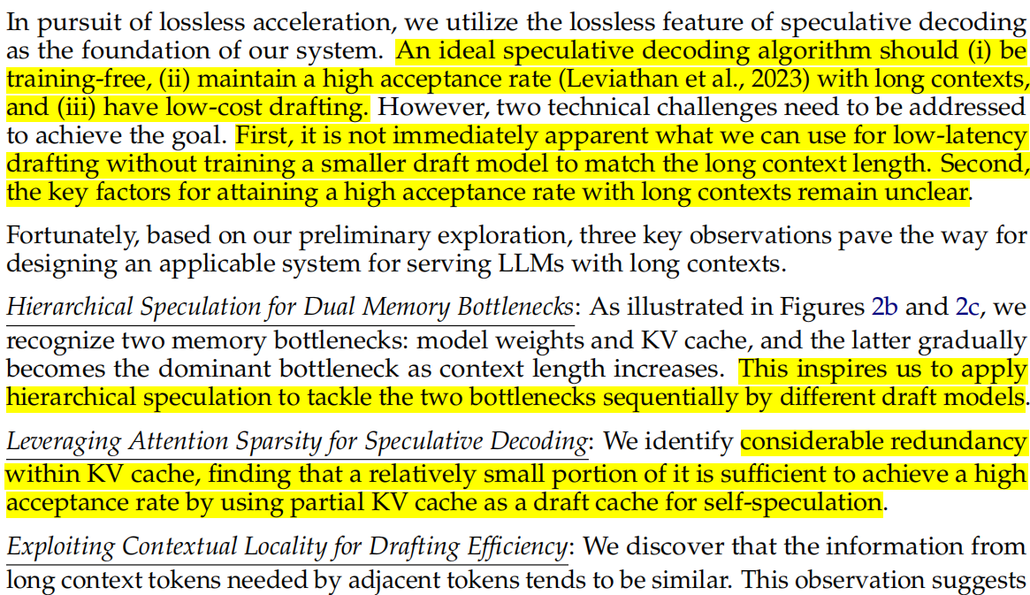
TriForce
Observation

Slide 5
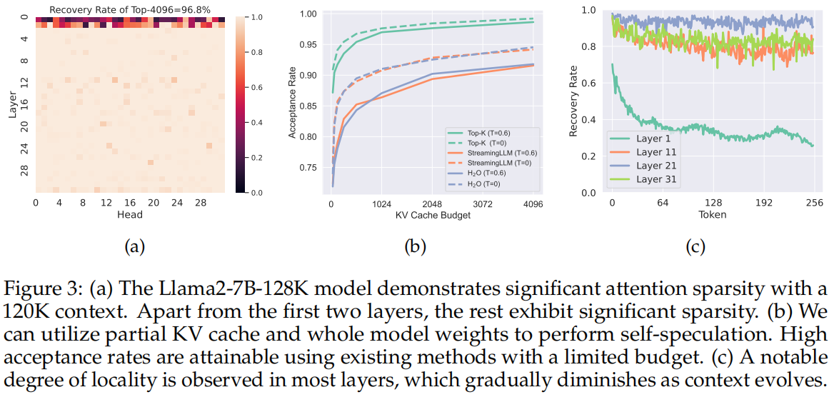
TriForce
Observation
Leveraging Attention Sparsity for Speculative Decoding
Exploiting Contextual Locality for Drafting Efficiency
The presence of sparsity within the attention blocks suggests that a fraction of KV cache could serve as a draft cache to attain a high acceptance rate during self-speculative decoding. Since KV cache is the bottleneck under this setting, we can load whole model
weights with partial KV cache as a draft model
As shown in Figure 3c, it leads to high recovery across almost all layers and a slowly decreasing trend as the number of tokens increases.
This observation allows for a single construction of the cache to suffice for multiple decoding steps, thereby amortizing the latency of constructing draft cache and
boosting efficiency.

Slide 6
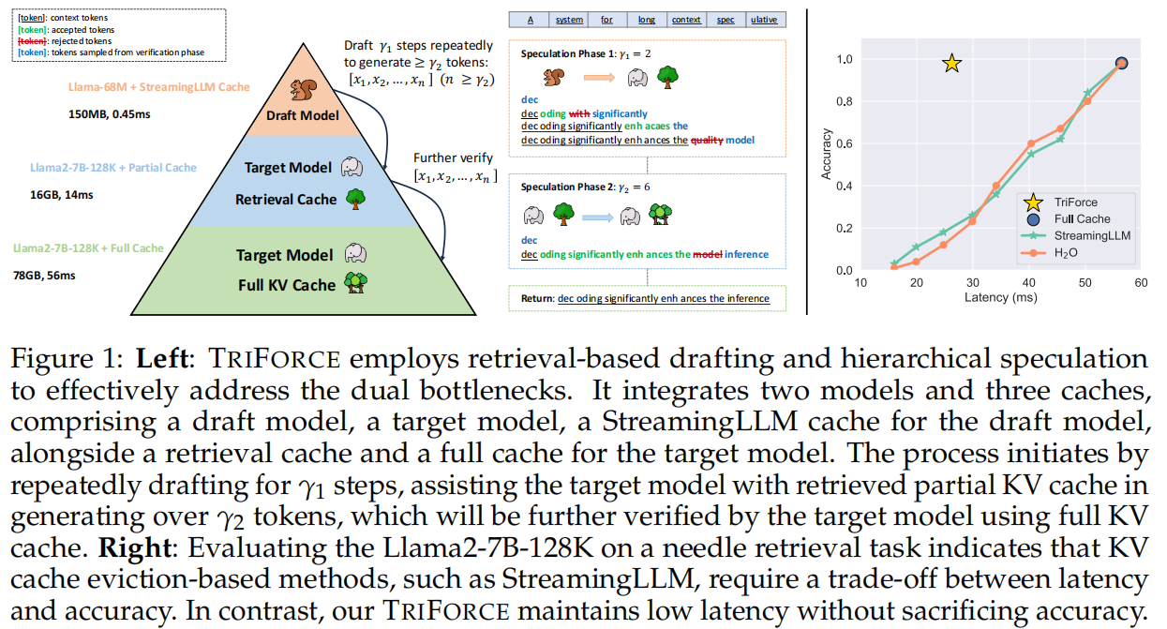
TriForce
Overview

Slide 7
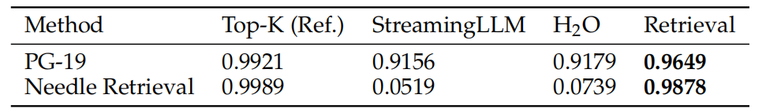
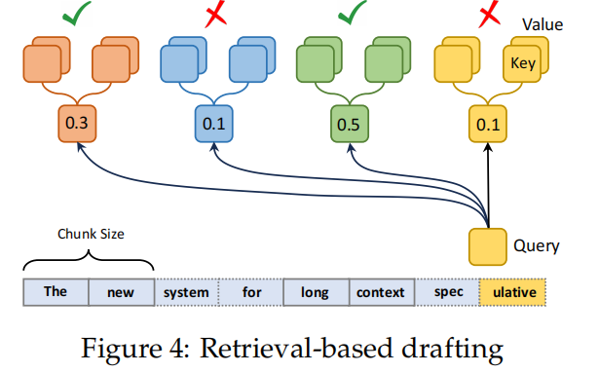
TriForce
Retrieval-based Drafting
In scenarios requiring long-term contextual dependencies, methods like StreamingLLM and H2O underperform due to their cache updating strategies, which are ineffective at accurately retrieving detailed contextual information because they inevitably and irrecoverably discard KV pairs
Calculate the attention between a given query and the average key cache within each chunk.
This method effectively highlights the most relevant chunks, enabling us to gather KV cache with a fixed budget based on the scores
The necessity of keeping the entire KV cache in our settings allows us to select KV cache more freely.

Slide 8
TriForce
Hierarchical Speculation
While addressing the KV cache bottleneck enhances efficiency, the requirement to load whole model weights for drafting reintroduces latency, shifting the bottleneck to model weights again.
To tackle this challenge, we implement a hierarchical system, as illustrated in Figure 1. This system employs a secondary, lightweight model with StreamingLLM cache to perform initial speculations for the target model with retrieval-based cache (which serves as a draft model for the target model with full KV cache). By establishing this sequential speculation hierarchy, we effectively reduce drafting latency and accelerate overall inference.

Slide 9
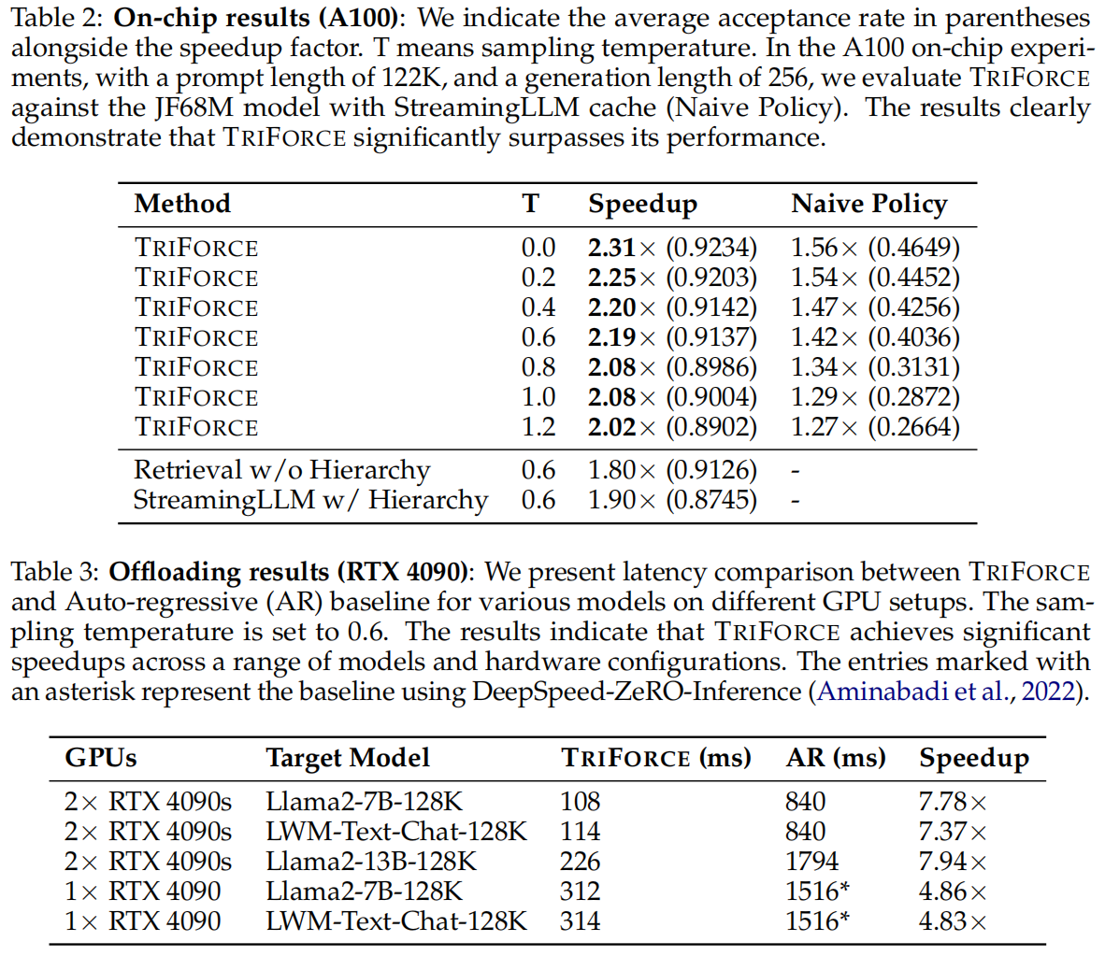
TriForce
Results

Slide 10
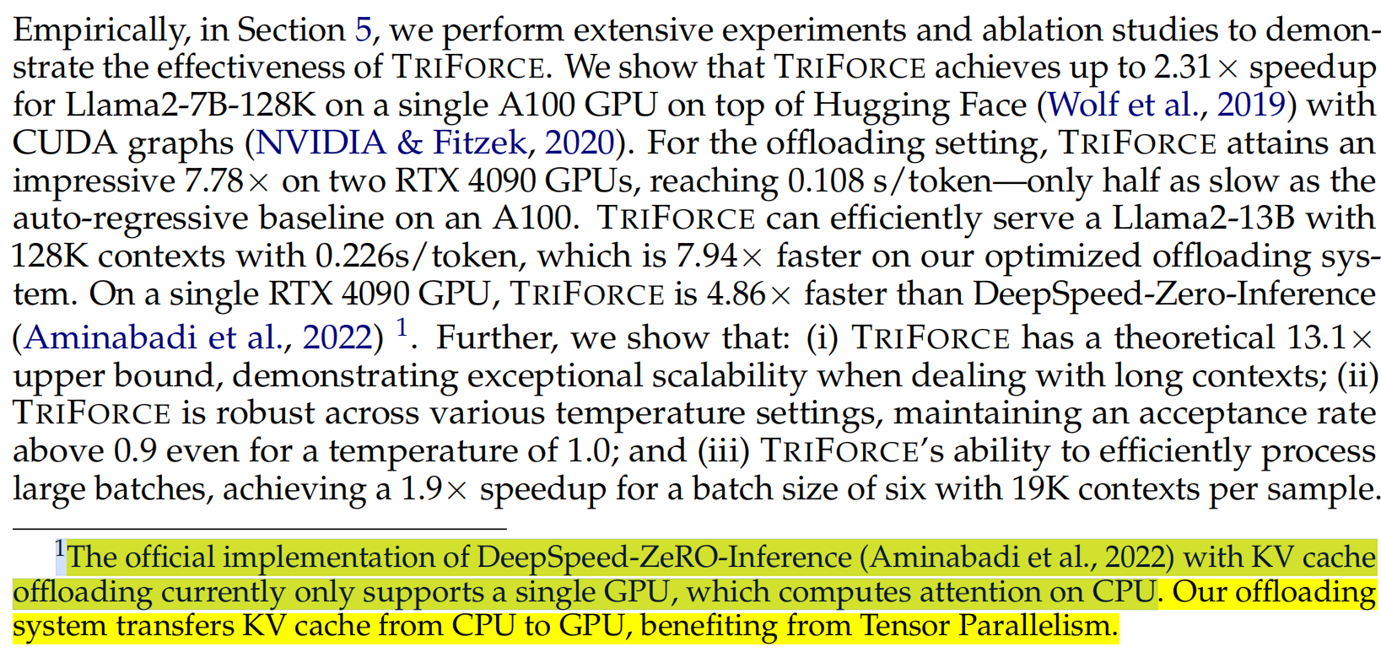
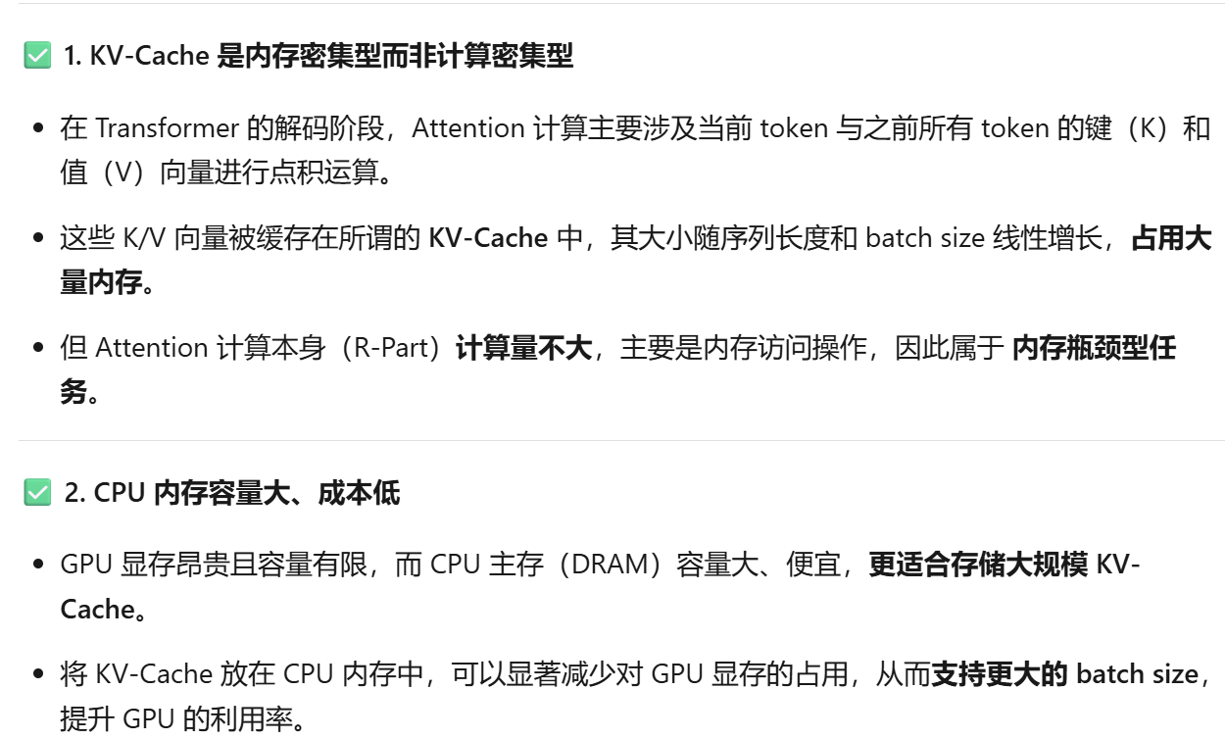
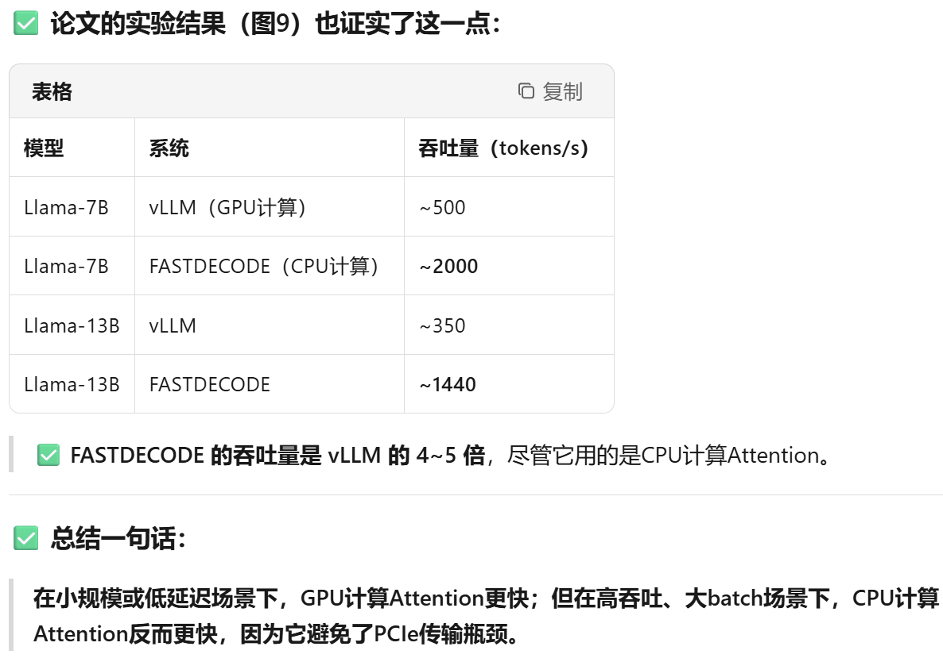
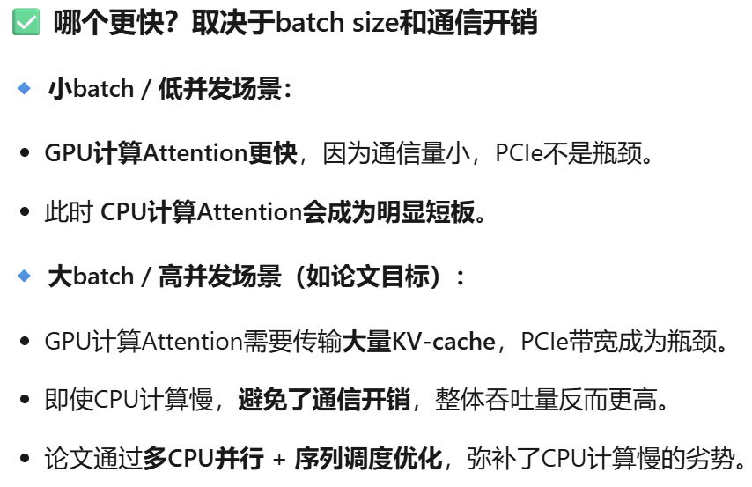
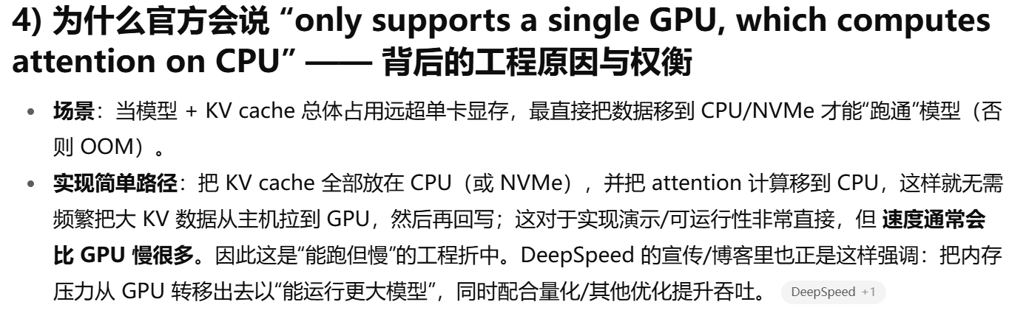
TriForce
Some details
FASTDECODE 中 CPU 存 KV Cache 并计算的原因：

